Slide 1
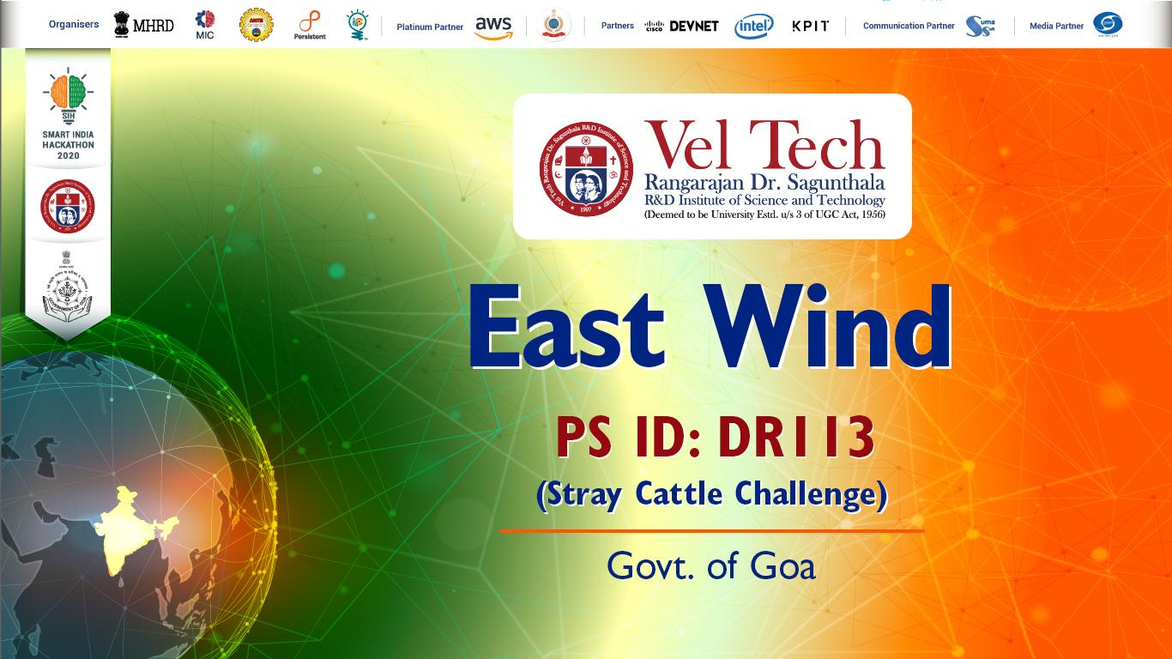

Slide 2
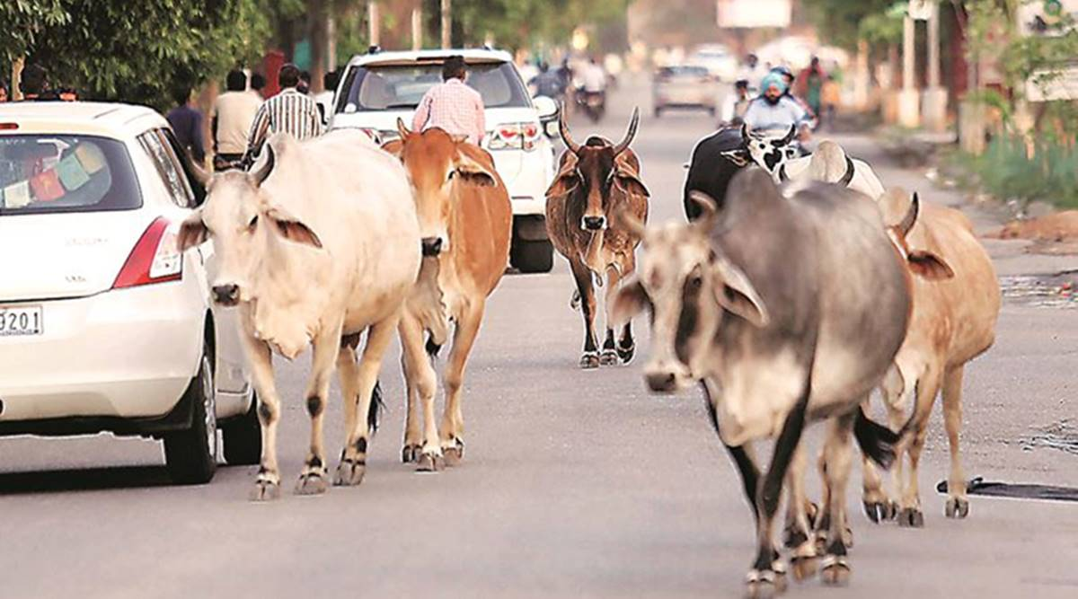
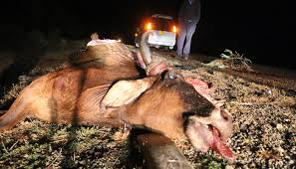
Problem Statement
Checking the menace of stray cattle in State of Goa by involving Municipalities, Panchayats, Animal Husbandry, NGO and Civic Forum.
Limiting the number of stray cattle on roads, public places, tourist places etc, thereby preventing road accidents and other disasters.
Engagement of public for the same.
Proper flow of information amongst the users, drivers and government and non-government authorities.

Slide 3
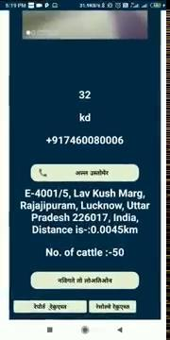

Slide 4

Our Solution- CattleCare App
The basic features asked for
User-friendly interface, so simple that anyone can use it.
Connectivity amongst the authorities for exchange of data directly from the database.
Realtime reporting of the cattle using the current location.
Navigation of a single driver towards the nearest reported endpoint to avoid hassle and management.
All updates from lodging till completion of your request.

Slide 5
What’s more…...
Donation Service for the cattle. Your support indeed makes a difference.
News and blogs related to various animal welfare activities going around.
Adoption of cattle facility allowing you to adopt cattle from a NGO you wish.
Scrutinize the complaints to identify and catch hold of unethical ones.
Guaranteed rewards after completion of the request.
Profile system for the user with authentication and history of donation and report history.
Two point authentication for the driver.

Slide 6






Technology Stack:
Compatible with all Android Versions from
4.4 to 10.0
Google Firebase
Razorpay Payment Services
Google Location Services API
Java 12 Language
Android Studio
XML Layout

Slide 7
Monthly Budget- Sample Scenario
Key Metrics | Quantity | Cost
Assumed Number of Users (Phone Verifications) | 1,00,000 | 900$ = 63000
Request Per User Per Month Total Requests (Number of uploads) | 4 4,00,000 | For upload operations $1.66 = 116.20
Storage | 600 KB per image 4,00,000 * 600= 240000000 KB = 210 GB | For image storage $5.33 = 373.1
Total Storage Cost= 63489.30/-

Slide 8
Extra Costs-
User Incentives- 5% of Revenue Generated
Bug Fixing- 5000
Total Cost= 63489.30 + 5000
= 70K/ month

Slide 9
Revenue Generation
Google Ads
(CPM and CPC)
Fine Collection
Publicity of Other Organisations
If the stray cattle is claimed within a period of 7 days | 3000/- + delivery
If stray cattle is claimed beyond a period of 7 days but within 15 days | 5000/- + delivery
In case the stray cattle is not claimed within 15 days | Auction of the cattle can be done

Slide 10
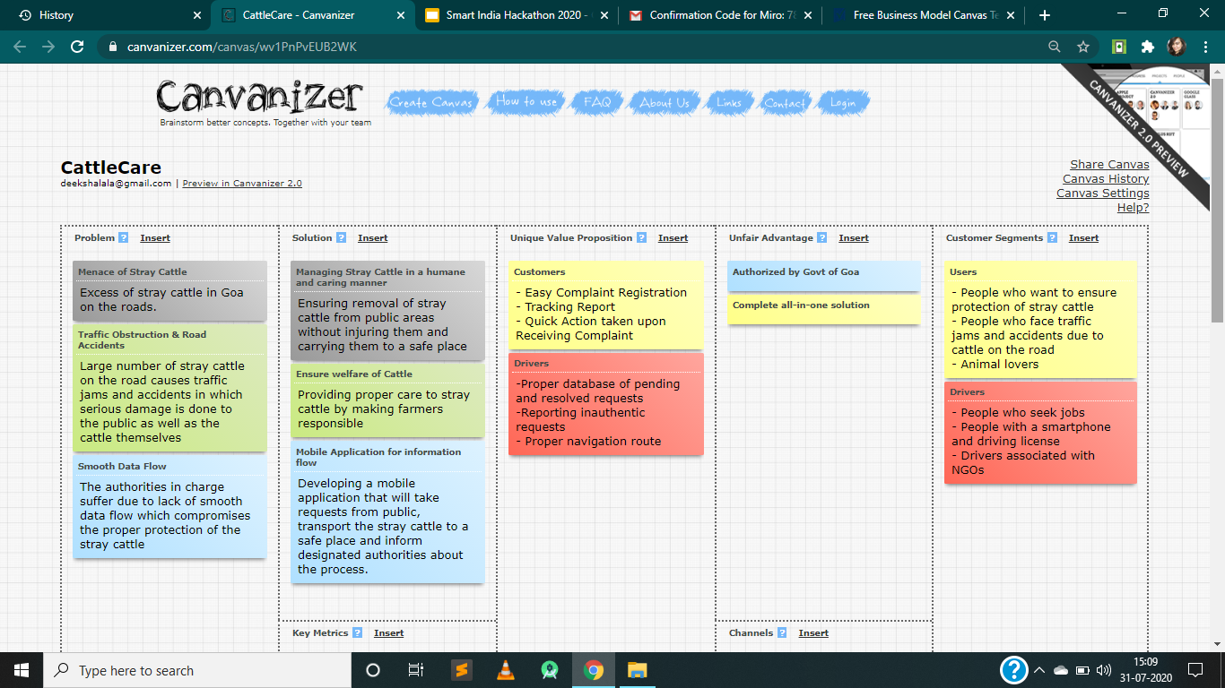
Business Model Canvas

Slide 11
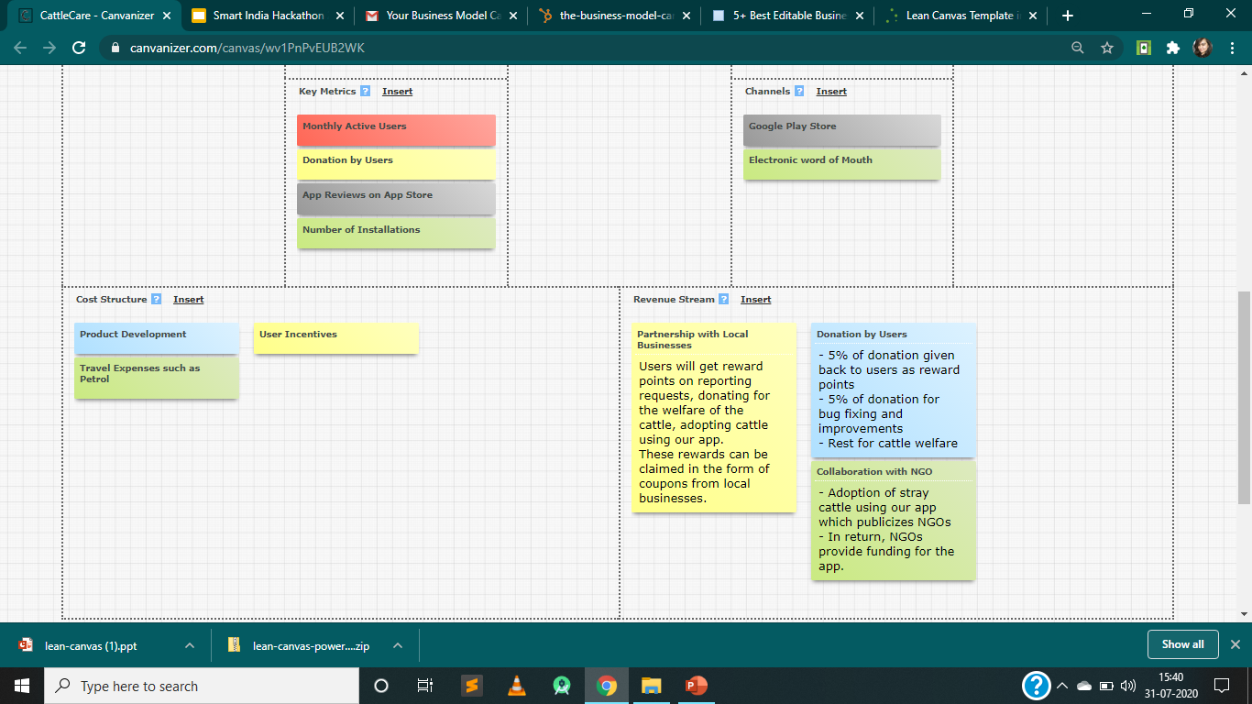

Slide 12
What more Technologies could have been implemented?
Why we chose not to implement them?
Camera Installation
Satellite Image Detection
Cost Ineffective
Out of Technology Description
Neglect the engagement of public

